Slide 1
Agenda
Protection State
Access Control Matrix Model
Copying/Owning/Attenuation Of Privilege

Slide 2
Protection State (1/2)
The state of a system is the collection of the current values of all memory locations, all secondary storage, and all registers and other components of the system. The subset of this collection that deals with protection is the protection state of the system.
An access control matrix is one tool that can describe the current protection state.

Slide 3
Protection state (2/2)
Consider the set of possible protection states P. Some subset Q of P consists of exactly those states in which the system is authorized to reside.
So, whenever the system state is in Q, the system is secure. When the current state is in P – Q, the system is not secure.
Our interest in representing the state is to characterize those states in Q, and our interest in enforcing security is to ensure that the system state is always an element of Q.
Characterizing the states in Q is the function of a security policy; preventing the system from entering a state in P – Q is the function of a security mechanism.

Slide 4
Access Control Matrix Model (1/2)
The access control matrix model is the most precise model used to describe a protection state.
It characterizes the rights of each subject (active entity, such as a process) with respect to every other entity.
The set of all protected entities (that is, entities that are relevant to the protection state of the system) is called the set of objects O. The set of subjects S is the set of active objects, such as processes and users.
In the access control matrix model, the relationship between these entities is captured by a matrix A with rights drawn from a set of rights R in each entry a[s, o], where s ϵ S, o ϵ O, and a[s, o] ϵ R. The subject s has the set of rights a[s, o] over the object o. The set of protection states of the system is represented by the triple (S, O, A).

Slide 5
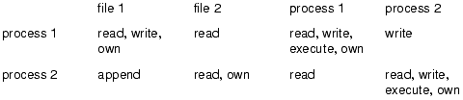
Access control Matrix Model (2/2)
The matrix shown below is an access control matrix where the system has two processes and two files and the set of rights is {read, write, execute, append, own}
The access control matrix model is an abstract model of the protection state, and when one talks about the meaning of some particular access control matrix, one must always talk with respect to a particular implementation or system.

Slide 6
Copying/Owning/Attenuation of Privilege (1/3)
Copy Right
The copy right (often called the grant right) allows the possessor to grant rights to another. By the principle of attenuation, only those rights the grantor possesses may be copied. Whether the copier must surrender the right, or can simply pass it on, is specific to the system being modeled. This right is often considered a flag attached to other rights; in this case, it is known as the copy flag.

Slide 7
Copying/Owning/Attenuation of Privilege (2/3)
Own Right
The own right is a special right that enables possessors to add or delete privileges for themselves. It also allows the possessor to grant rights to others, although to whom they can be granted may be system- or implementation-dependent. The owner of an object is usually the subject that created the object or a subject to which the creator gave ownership.

Slide 8
Copying/Owning/Attenuation of Privilege (3/3)
Principle of Attenuation of Privilege:
A subject may not give rights it does not possess to another.
If a subject does not possess a right over an object, it should not be able to give that right to another subject.
For example, if Matt cannot read the file xyz, he should not be able to grant Holly the right to read that file. This is a consequence of the principle of attenuation of privilege.

Slide 9
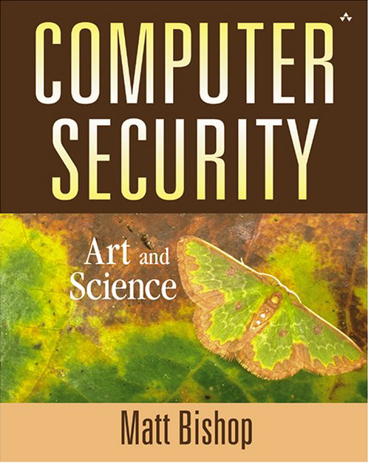
Book

